Slide 1





Tech Stack: GPT-4o-mini + LangChain + ChromaDB
HealthLens AI
AI-Powered YouTube Health Video Q&A Assistant
Dimitrios Gretsistas

Slide 2
01
1. Problem & Solution Overview
02
2. Architecture & Data Pipeline
03
3. Agent Tools & UX (Speech)
Contents
04
4. Evaluation & Results
Agenda
05
5. Observability (LangSmith)
06
6. Deployment
07
7. Future Improvements
08
8. Conclusion & Live Demo
Dimitrios Gretsistas
02

Slide 3








Problem → Solution → Core Features
Problem
Solution
Core Features
Health videos are long and hard to search; users waste time hunting for specific advice.
Ask natural-language questions directly about YouTube health videos and get grounded answers.
Timestamped answers
Multi-video library
Memory support for follow-ups
AI-powered retrieval
Speech input/output
Multilingual responses
"Instead of watching a 2-hour podcast to find one answer, users can directly ask the AI."
03

Slide 4












End-to-End System Architecture
LangChain Agent
ChromaDB
GPT-4o-mini
Frontend (UI)
FastAPI Backend
(embeddings store)
(routing)
(grounded answer)
Transcript Sources/Tools
Output
Primary: Supadata transcript retrieval
Answer + supporting timestamps
Fallback: Whisper transcription
04

Slide 5














Data Sources, Chunking, and Metadata
Data Sources
Preprocessing
Chunking
YouTube transcripts
Transcript cleaning
Supadata API
Semantic chunking
RecursiveCharacter TextSplitter
Whisper fallback transcription
Duplicate filtering
Stored Metadata
Why Metadata Matters
Metadata enables reliable timestamp generation in answers.
video_id
timestamps
video_title
05

Slide 6








Retrieval-Augmented Generation (RAG) Pipeline
7-Step Flow
Guardrails
1
2
3
4
1
2
3
4
similarity_search_with_score()
Similarity threshold filtering
Retrieve transcript
Chunk transcript
Create embeddings
Store in ChromaDB
Duplicate chunk filtering
5
6
7
Timestamp source generation
5
6
7
Hallucination-protection prompts
Generate grounded answer with timestamps
Retrieve relevant chunks
Send context to GPT-4o-mini
06

Slide 7



LangChain Agent: Routing, Memory, Language Matching
Memory
Agent System
Stores recent conversation history to support follow-up questions.
Router prompt
Multi-tool architecture
PromptTemplates
Conversation memory
Language Support
Language matching
If the user asks in another language, the AI answers in the same language automatically.
07

Slide 8













Implemented Tooling (Router-Selected)
Selected Tool
video_qa
summary
Router Agent
ingredient_extraction
macro_calculator
How it works: The router chooses the best tool automatically to improve flexibility and scalability.
health_safety
meal_suggestion
shopping_list
08

Slide 9







Speech Input/Output for Accessibility
Speech Features
Speech-to-text (user asks by voice)
Text-to-speech (AI reads answers)
Browser speech synthesis
Stop-reading functionality
Why it matters
Better usability on mobile
Accessibility support
09

Slide 10








Evaluation Setup (LLM-as-a-Judge)
Evaluation Method
Metrics
GPT-4o-mini used as LLM-as-a-judge
Tools Used
LangSmith tracing
Correctness
Answer Relevance
Terminal evaluation pipeline
Grounding Note: Evaluations were grounded on retrieved sources.
Bias & Fairness
Hallucination
10

Slide 11



Results and Key Weaknesses
Single-Video RAG
Library Mode
Most answers scored 5/5 across metrics
Works well for specific questions
Strong hallucination safety
Harder for broad cross-video retrieval
Main Weakness: Chronological reasoning—semantic retrieval struggles with "what came first" questions.
"Semantic retrieval does not always understand temporal ordering."
16

Slide 12
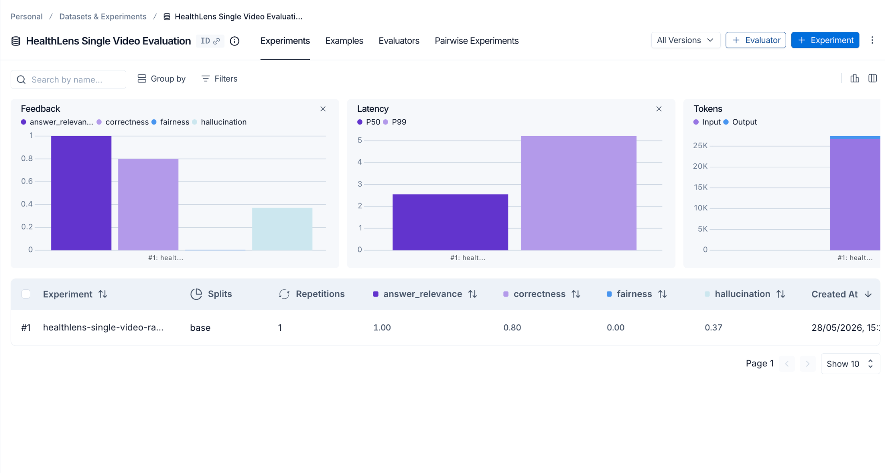

LangSmith Traces (What We Inspected)
Trace View Focus
User question
Tool execution
Retrieved chunks
Token usage
Prompt
Latency
Final answer
Why it helped: LangSmith made it easier to debug and evaluate the agent end-to-end.
Dimitrios Gretsistas | DUBAI 2026
12

Slide 13
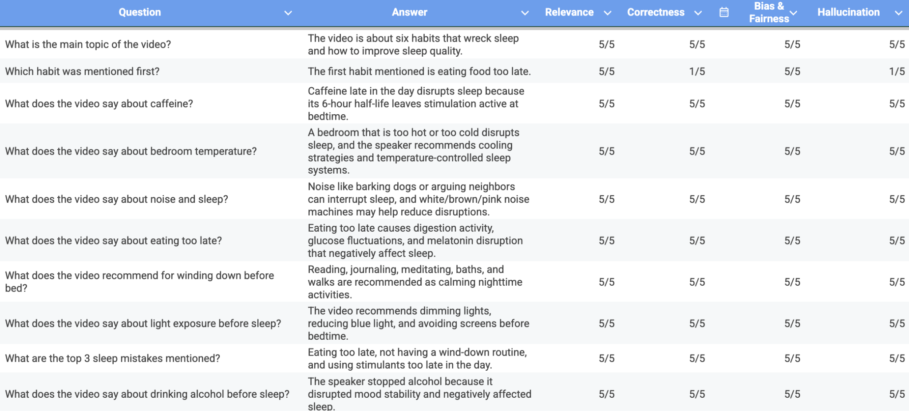
Terminal Tests
Dimitrios Gretsistas | DUBAI 2026
12

Slide 14


Deployment and Security
Deployment Stack
Security Practices
Frontend: HTML/CSS/JavaScript
.env protection
Backend: FastAPI
.gitignore usage
Hosting: Render
API keys hidden
Source: GitHub repository
Local-first development with deployment-ready architecture.
Dimitrios Gretsistas | DUBAI 2026
13

Slide 15








Future Improvements
Better chronological reasoning
Hybrid search
Better cross-video retrieval
Reranking system
Larger video library
Advanced memory
Dimitrios Gretsistas | DUBAI 2026
14

Slide 16


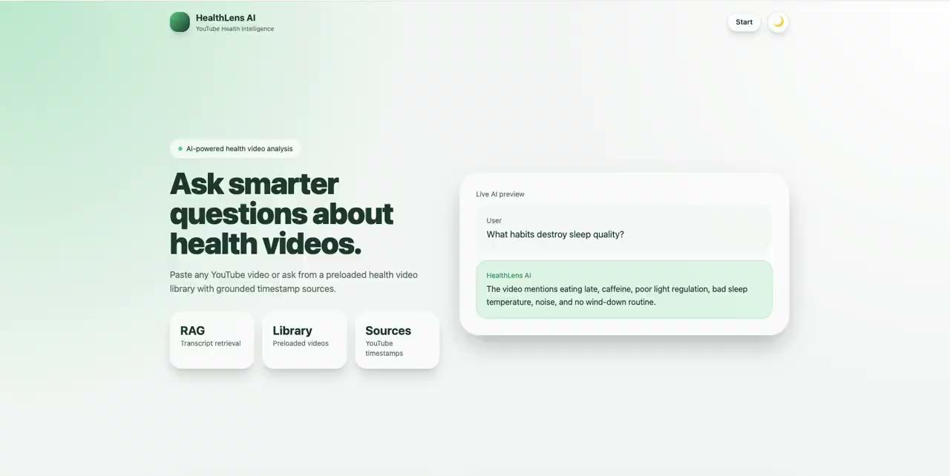

Thank You
Live Demo

